Slide 1
Building Instruments
Module 4.1

Slide 2



This Module Discusses…
Constructing Survey Instruments
Decisions in Instrument Design
Self Administered Questionnaires

Slide 3
Constructing Instruments
Guidelines for Writing Good Questions

Slide 4
Instrument
A generic term that researchers use for the device, such as a questionnaire, used to measure a construct.

Slide 5
Questionnaire Quality and Design
Questionnaire design is one of the most critical stages in the survey research process.
  A questionnaire (survey) is only as good as the questions it asks—ask a bad question, get bad results.
  Composing a good questionnaire appears easy, but it is usually the result of long, painstaking work.
  The questions must meet the basic criteria of relevance and accuracy, therefore, use of existing (previously validated) instruments is always recommended.

Slide 6
PRINCIPLES
OF
WRITING QUESTIONS FOR SURVEYS
01
02
03
04
05
06
07
Match the Research Objective
  Questions in the instrument should be related with the topic and purpose of survey.
Research Topic
  Influence of Employee Job Satisfaction on Organizational Commitment.
Research Instrument
  Composed of questions from
    Job Satisfaction Scale
    Organizational Commitment Scale

Slide 7
PRINCIPLES
OF
WRITING QUESTIONS FOR SURVEYS
01
02
03
04
05
06
07
Keep it Simple
  Be brief, objective, simple, and specific
  No jargon or technical concepts
  Use simple language
  Use words that are familiar to the respondents.
Example:
  Are you cognizant of the variables influencing your decision?
Better Question:
  What variables influenced your decision?

Slide 8
PRINCIPLES
OF
WRITING QUESTIONS FOR SURVEYS
01
02
03
04
05
06
07
Avoid the Common Mistakes
  Loaded Questions - that produce a particular emotional response by using biased wordings or asking something controversial.
Example:
  How important are health benefits?
Better Question:
  How important are health plans compared to other employee benefits?

Slide 9
PRINCIPLES
OF
WRITING QUESTIONS FOR SURVEYS
01
02
03
04
05
06
07
Avoid the Common Mistakes
  Leading Questions - phrased in a manner that respondents eventually select the answer the researcher wants them to.
Example:
  What are your thoughts on the wonderful upgrades and bonus we got for you?
Better Question:
  What are your thoughts on the changes to the contract?

Slide 10
PRINCIPLES
OF
WRITING QUESTIONS FOR SURVEYS
01
02
03
04
05
06
07
Avoid the Common Mistakes
  Double Barreled Questions - covering several issues at once.
Example:
  How effective do you find the new transportation and flexible leave policy?
Better Question:
  How effective do you find the new transportation policy?
  How effective do you find the new flexible leave policy?

Slide 11
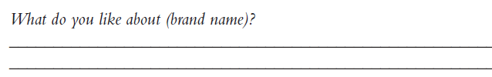
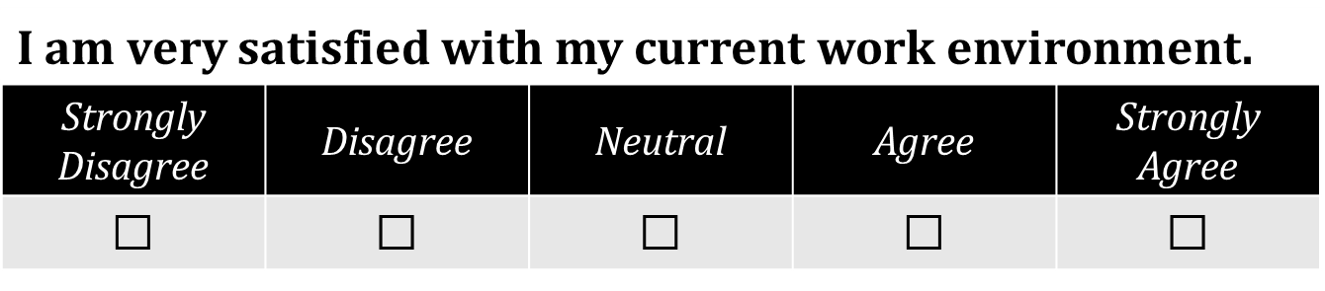
PRINCIPLES
OF
WRITING QUESTIONS FOR SURVEYS
01
02
03
04
05
06
07
Determine Question Types
  Open Ended
  Closed Ended

Slide 12
PRINCIPLES
OF
WRITING QUESTIONS FOR SURVEYS
01
02
03
04
05
06
07
Construct categories that are
  Mutually Exclusive – response categories should not overlap.
What is your nationality?
☐ Emirati
☐ GCC national
☐ European
☐ American

Slide 13
PRINCIPLES
OF
WRITING QUESTIONS FOR SURVEYS
01
02
03
04
05
06
07
Construct categories that are
  Collectively Exhaustive – include all possible response options.
What is your nationality?
☐ Middle Eastern
☐ South East Asian
☐ European
☐ American
☐ African
☐ Australian

Slide 14
PRINCIPLES
OF
WRITING QUESTIONS FOR SURVEYS
01
02
03
04
05
06
07
Use Multiple Items
  Measure complex and abstract constructs using multiple item scales to ensures content and construct validity.
Time Orientation Scale | SD ----------- SA
I always plan things ahead. | 1 | 2 | 3 | 4 | 5
Time is moving quickly. | 1 | 2 | 3 | 4 | 5
The pace of my life is fast. | 1 | 2 | 3 | 4 | 5
I see the future full of possibilities. | 1 | 2 | 3 | 4 | 5
I am facing my future with confidence. | 1 | 2 | 3 | 4 | 5
I never feel as if time is standing still. | 1 | 2 | 3 | 4 | 5
Living for the future is important to me. | 1 | 2 | 3 | 4 | 5

Slide 15
PRINCIPLES
OF
WRITING QUESTIONS FOR SURVEYS
01
02
03
04
05
06
07
Pilot Test
  Distribution of research instrument to a small group in the target population, to identify discrepancies and errors.
Pilot Test
Fix Errors
Collect Data

Slide 16
Major Decisions
Important Considerations in Questionnaire Design

Slide 17
Important Considerations
What should be asked?
How should questions be phrased?
In what sequence should the questions be arranged?
What questionnaire layout will best serve the research objectives?
How should the questionnaire be pretested? Does the questionnaire need to be revised?

Slide 18
Asking Questions
Questionnaire Relevancy
All information collected should address a research question.
Questionnaire Accuracy
Increasing the reliability and validity requires:
  simple, understandable, unbiased, unambiguous, and nonirritating words.
  questionnaire design that facilitates recall and motivate respondents to cooperate.
  Proper question wording and sequencing to avoid confusion and biased answers.
Important Considerations

Slide 19
Question Phrasing
Wording Questions
  Open Ended: ask respondents to answer in their own words.
  Fixed Alternative: respondents are given specific, limited-alternative responses
Mode of data collection will influence question phrasing
  Questions for mail, Internet, and telephone surveys must be less complex than those used in personal interviews.
  Questionnaires for telephone and personal interviews should be written in a conversational style.
Important Considerations

Slide 20
Question Sequencing
Order bias
  Bias caused by the influence of earlier questions in a questionnaire or by an answer’s position in a set of answers.
Funnel technique
  Asking general questions before specific questions in order to obtain unbiased responses.
Filter question
  A question that screens out respondents who are not qualified to answer a second question.
Pivot question
  A filter question used to determine which version of a second question will be asked.
Important Considerations

Slide 21
Questionnaire Layout
Traditional Questionnaires
Format
  Multiple-grid, where several similar questions arranged in a grid format.
Questionnaire Title
  Captures the respondent’s interest
  Underlines the importance of the research
  Emphasizes the interesting nature of the study
  Appeals to the respondent’s ego
  Emphasizes the confidential nature of the study
Important Considerations

Slide 22
Questionnaire Layout
Internet Questionnaires
Graphical User Interface (GUI)
  The researcher can control the background, colors, fonts, and other features displayed on the screen so as to create an attractive and easy-to-use interface.
Layout Issues
  Paging layout - going from screen to screen.
  Scrolling layout – entire questionnaire appears on one page and respondent has the ability to scroll down.
Important Considerations

Slide 23
Pretesting Questions
Pretesting Process
Seeks to determine whether respondents have any difficulty understanding the questionnaire.
Also tests whether there are any ambiguous or biased questions.
Preliminary Tabulation
A tabulation of the results of a pretest to help determine whether the questionnaire will meet the objectives of the research.
Important Considerations

Slide 24
Self Admin. Questionnaires
Use of Questionnaires in Survey Research

Slide 25
Self-administered Questionnaires
Self-completion questionnaires are a data collection tool where respondents write answers on a form and no interviewers are present to guide the responses.
Advantages:
  Fast route to data collection
  Cost efficient
  Less biased
  Convenient
Disadvantages:
  Lack of researcher control
  Only simple questions
  No probes for clarification
  Risk of missing data

Slide 26

Diaries as a Form of Self-completion Questionnaire
An alternative to structured observation in quantitative research where events are tracked by respondents as they occur.
Key features
  Questionnaire booklet
  More intrusive & time consuming
  Structured or Unstructured
  Counters memory issues

Slide 27
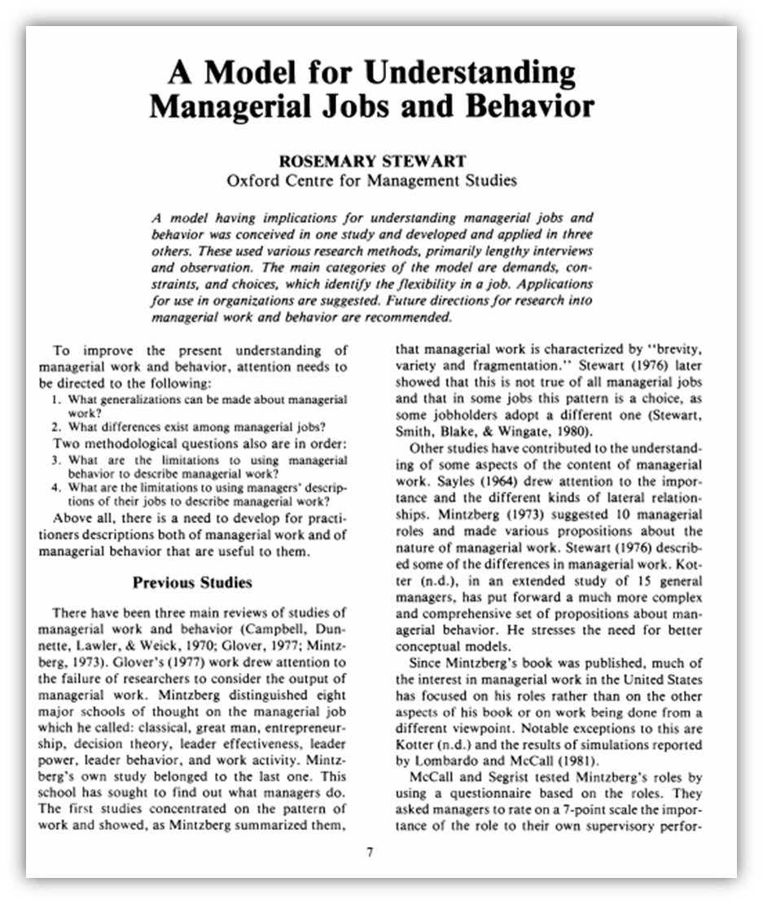
Use of Diary in Survey Research
Example
‘The diary method was chosen instead of observation because the research aimed to study more than 100 managers in a large number of companies. This aim could not be achieved by observation without a large team of observers’
(Stewart, 1967)

Slide 28
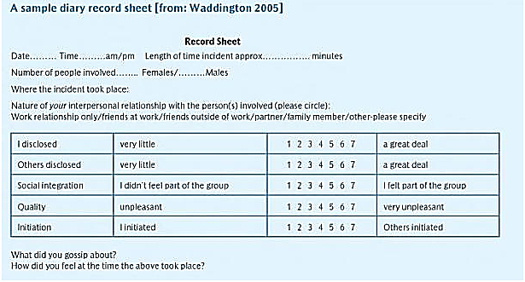

Slide 29
Techniques to Improve Response Rates
Write a personalized cover letter
Keep the questionnaire short and simple
Start with interesting questions
Design an attractive and easy layout
Provide clear directions for answering
Send questionnaires only to those who are part of the target population
Issue gentle reminders to the participants, or
Provide incentive for participating in the study.

Slide 30
Guidelines for Writing Questions
  Avoid complexity: Use simple language.
  Avoid leading and loaded questions.
  Avoid ambiguity: Be as specific as possible.
  Avoid double-barreled items.
  Avoid making assumptions.
  Avoid burdensome questions that tax the respondent’s memory.
  Make certain questions generate variance.
Guidelines for Questionnaire Layout
  Always use an uncluttered layout.
  Aim for clear presentation.
  Arrange fixed answers vertically for closed ended questions.
  Give clear instructions about how to respond.
  Keep questions and answers together.
In Summary

